Slide 1
Learning C++ through memory injection
Presented as an ISP,
2016

Slide 2
Why bother?
Learning through a real-world problem
Immediate practical use
Numerous platforms, for numerous different goals
Wanted to improve my Windows computer where Microsoft wouldn’t
Learning ASM (Assembly Language) *
Learning low-level (processor, memory & OS) mechanics

Slide 3
Programming languages
C++ - a general-purpose programming language
A ‘veteran’ in programming
Used almost everywhere
ASM – a lower-level programming language
Closest and fastest way to interact with the processor
Full control over computer

Slide 4
C++
ASM
Bytecode
pushq %rbp
movq %rsp, %rbp
movl $.LC0, %edi
movl $0, %eax
call printf
movl $0, %eax
popq %rbp
ret
0000 55 0001 4889E5 0004 BF000000 0009 B8000000 000e E8000000 0013 B8000000 0018 5D 0019 C3
printf("Mechanics 101");
return(0);
Processor

Slide 5
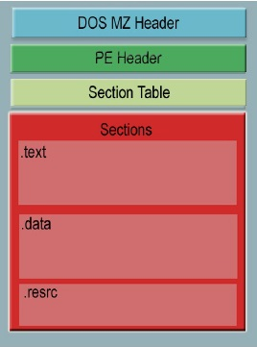
PE Structure & MEMORY
Program =
Executable =
Portable Executable (PE)

Slide 6
Memory patching
Bytecode
0000 55 0001 4889E5 0004 BF000000 0009 B8000000 000e E8000000 0013 B8000000 0018 5D 0019 C3
Changing code in memory to alter the behavior of a program

Slide 7

Memory Injection
The smart burglar

Slide 8
Memory injection + patching
You
“Send to Joe!”
“Send to Joe!”
Message dispatcher
sends
Joe
Program
Message for Joe
Also known as hooking, lets you ‘redirect’ the execution flow

Slide 9
Memory injection + patching
You
“Send to Joe!”
Message dispatcher
sends
Michael
Program
Message for Joe
“Send
to Joe!”
“Send
to Michael!”
Injected DLL
Also known as hooking, lets you ‘redirect’ the execution flow

Slide 10
Memory injection + patching
You
“Send to Joe!”
Message dispatcher
Program
Message for Joe
“Send
to Joe!”
Don’t send at all
Injected DLL
Also known as hooking, lets you ‘redirect’ the execution flow

Slide 11
Practical examples
The power of memory manipulation

Slide 12
How I did this – Part 1
The injector

Slide 13
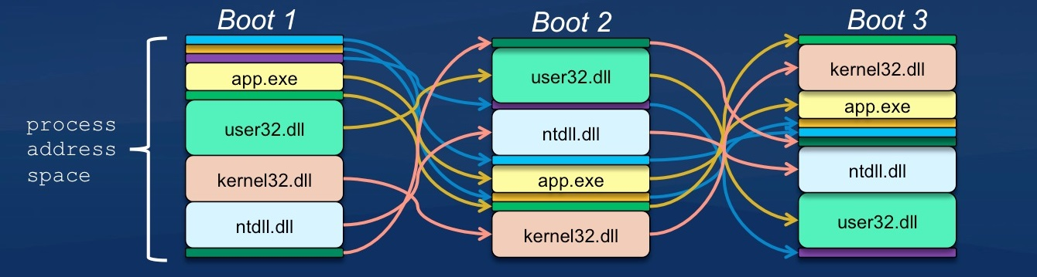
Address Space Layout Randomization (ASLR)

Slide 14
How I did this – Part 1
Open process for editing
Get address of LoadLibraryA function (ASLR)
Allocate enough memory in target to put the injectable DLL inside
Write DLL bytes to that memory location
RtlCreateUserThread – make the new memory region a thread and execute it
The injector

Slide 15
How I did this – PART 2
Calculate memory addresses of where to patch and jump
Reverse engineering
The injectable DLL

Slide 16
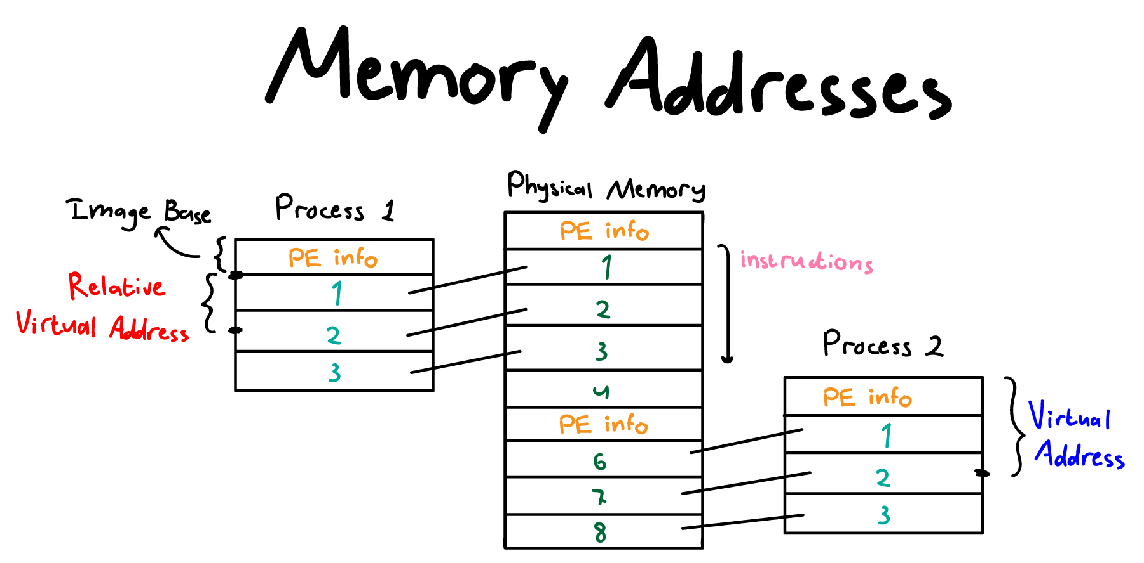

Slide 17

How I did this – PART 2
Dynamic trampoline (in target program)
Overwrites specific place
Jumps to receiver
Dynamic receiver (in injected DLL)
Begins with the overwritten instructions to preserve normal logic
Backs up registers & creates stack space
Calls a C++ function in injectable DLL
Restores stack and registers
Jumps back to continue expected code flow
The injectable DLL

Slide 18
Memory injection + patching
You
“Send to Joe!”
Message dispatcher
sends
Michael
Program
Message for Joe
“Send
to Joe!”
“Send
to Michael!”
Injected DLL

Slide 19
Presentation resources
http://techabreakk.com/wp-content/uploads/2015/08/04700566-photo-trustworthy-computing-aslr.jpg
http://nagareshwar.securityxploded.com/wp-content/uploads/2013/10/PE-architecture.jpg
http://realestate.nd.edu/assets/88234/original/realestate1.jpg
http://www.ilovegenerator.com/large/i-love-love-asm-131100977135.png

